Slide 1
Chapter 1
1. Turing proposed in 1937 that all computations could be carried out by a particular kind of machine, which is now called (a Turing machine). PAGE 12
2. (The instruction set architecture) is the complete specification of the interface between programs that have been written and the underlying computer hardware that must carry out the work of those programs. PAGE 14
3. suppose we wish to add the number 13 to - 5 , where 13 is represented as 0000000000001101 and -5 is represented as 111011. If we represent the two values with the same number of bits using sign extension, we have
0 0 0 0 0 0 0 0 0 0 0 0 1 1 0 1
+ (1 1 1 1 1 1 1 1 1 1 1 1 1 0 1 1)
-------------------------------------------
0 0 0 0 0 0 0 0 0 0 0 0 1 0 0 0 PAGE31

Slide 2
Chapter 2
4. a binary string is 0011110101101110. converted value of its equivalent hex digit is (3D6E).
PAGE42
5. The p-type transistor works in exactly the opposite fashion from the n-type transistor. When the gate is supplied with 2.9 volts, the p-type transistor acts like (an open(ed) circuit). PAGE53
6. We say that the set of gates {AND, OR, NOT} is (logically complete) because we can build a circuit to carry out the specification of any truth table we wish without using any other kind of gate. PAGE64

Slide 3
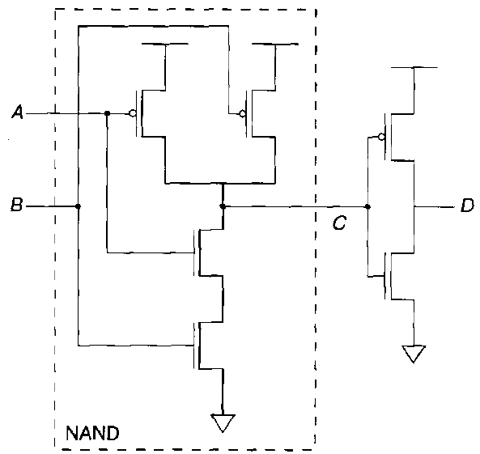
Chapter 3
7. PAGE57
8. (sequential logic circuits) are distinguishable from combinational logic circuits because, unlike combinational logic circuits, they contain storage elements that allow them to keep track of prior history information. ➔PAGE 71
9. 16 mega memory corresponds to the number of uniquely identifiable locations that can be specified with (24) address bits. ➔ PAGE68
A=1
B=0
D=(0)

Slide 4
Chapter 4
10. (A state diagram) is drawn as a set of circles, where each circle corresponds to one state, and a set of connections between some of the states, where each connection is drawn as an arrow. PAGE74
11. The FETCH phase obtains the next instruction from memory and loads it into (the instruction register (IR)) of the control unit. PAGE105
12. To keep track of which instruction is to be processed next, the control unit has a register that contains the next instruction's address. For historical reasons, that register is called (the program counter(PC)). PAGE101

Slide 5
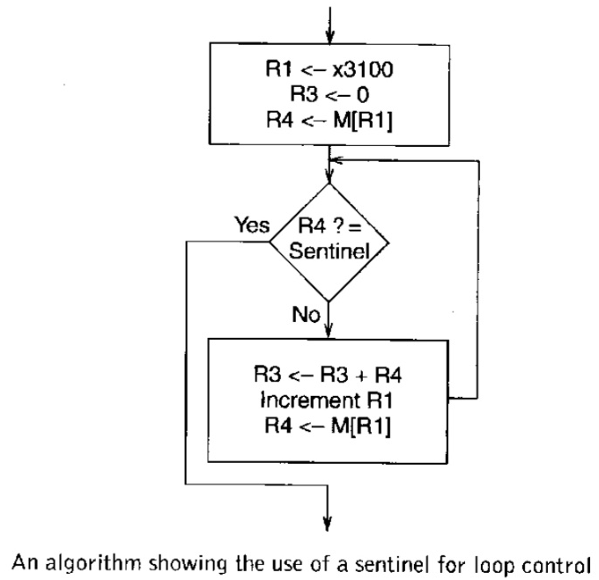
Chapter 5
13. If the operand is a part of the instruction, we refer to it as a literal or as (an immediate operand). PAGE118
14. LD opcode = 0010 and ST opcode = 0011 specify (the PC-relative (addressing)) mode. This addressing mode is so named because bits [8:0] of the instruction specify an offset relative to the PC. PAGE124
15. PAGE136
(sentinel)
(sentinel)

Slide 6
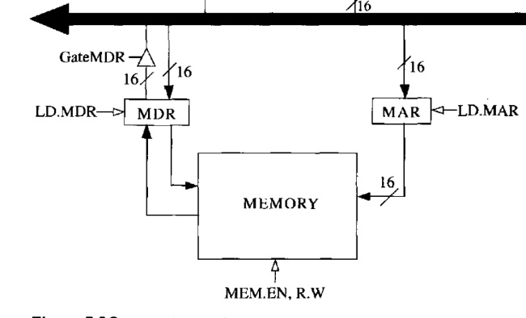
16. PAGE142
17. In the late 1960s, the concept of structured programming emerged as a way to improve the ability of average programmers to take a complex description of a problem and systematically decompose it into sufficiently smaller, manageable units that they could ultimately write as a program that executed correctly. The mechanism has also been called (systematic(al) decomposition) because the larger tasks are systematically broken down into smaller ones. PAGE156
( )

Slide 7
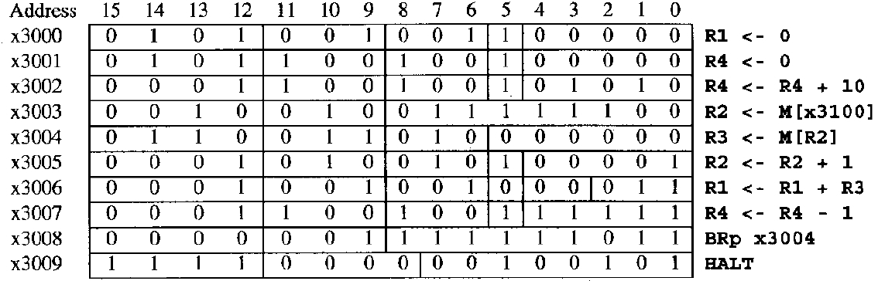
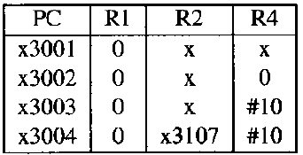
Chapter 6
18-20. x300A increments R4, preparing to load the next value. x300B decrements R3, indicating the number of values remaining to be tested. x300C loads the next value into R2. x300D branches back to x3008 to repeat the process if R3 still indicates more values to be tested. If R3 = 0, we have (exhausted) our tests, so R0 is set to 0, and the program terminates. PAGE 168-169
( )
( )

Slide 8
Chapter 6
(추가 설명)
1번 문제 : Universal Turing machine 도 정답으로 처리하였습니다.
6번 문제 : Logical completeness 는 주어와 문맥상 맞지 않아서 오답 처리하였습니다.
10번 문제 : finite state diagram은 문맥상 의미가 통하기 때문에 맞는 것으로 처리하였습니다.
13번 문제 : 많은 분들이 질문을 주셨는데 주술 관계와 문맥을 고려하였을 때 immediate 만 써서는 앞뒤가 맞지 않아서 오답 처리 하였습니다.
16번 문제 : 문제의 삼각형 구조가 Gate MDR이란 회로라는 의미가 아니고 GateMDR에 의하여 control되는 회로 라는 의미이기 때문에 control을 뜻하는 직선이 없으면 정답이 아닙니다.
17번 문제 : 사전을 찾아보니 systematical도 동일 의미로 사용하는 것으로 확인 되었습니다. Systematical로 기입 하신 세 분은 채점지를 들고 찾아 오시면 정답 처리 해드리겠습니다.

